Slide 1
5502A vs. 5500A and 9100
How our mid range Multi Product Calibrators compare

Slide 2
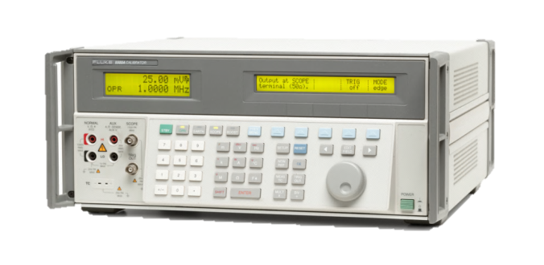
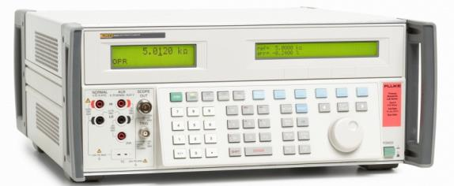
Points of differentiation with 5500A
5502A | 5500A
Max 20.5 A of dc and ac current | Max 11 A of dc and ac current
1100 M ohms max variable resistance | 330 M ohms max variable resistance
220 pF to 110 mF variable capacitance | 330 pF to 1.1 mF variable capacitance
Input Terminal Protection to 300V
Improved Chassis Design
Ergonomic Handles

Slide 3
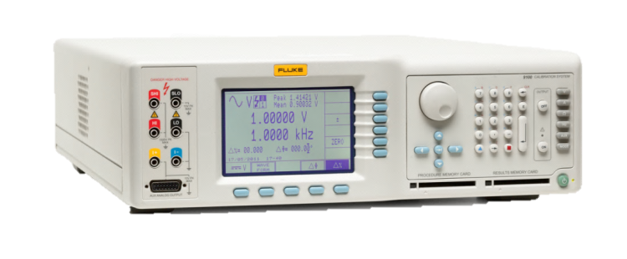
Points of differentiation with 9100
5502A | 9100
Basic dc accuracy is 50 ppm / year | Basic dc accuracy is 60 ppm / year
1100 M ohms max variable resistance | 400 M ohms max variable resistance
ACV to 500 kHz | ACV to 100 kHz
220 pF to 110 mF variable capacitance | 500 pF to 40 mF variable capacitance
.01 Hz to 2 MHz Frequency | 0.5 Hz to 10 MHz Frequency
No benefit to user | Lead connection mat
No such function available (recommend a 5320A or optional with 5080A) | 9100-135: Insulation/Continuity Tester Calibration Module
Obsolete and not available (use MET/CAL or computer automation) | PCMCIA Storage Modules

Slide 4
5502A vs. Transmille Competition

Slide 5
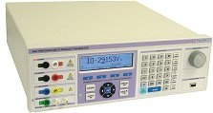
Points of differentiation with Transmille 3041
5502A | Transmille 3041
All functions of the 5502A have full operating ranges, without compromises, can drive full loads or perform over wide conditions. | The Transmille specs have good or adequate performance over a very limited set of conditions, cannot operate over a range of loads or testing times. Refer to the detailed comparison material of Fluke for more information.
20A current with strong compliance and long operating time | Specs to 30A, but usable only to 20A, poor compliance, short operating time
Fully variable resistance to 1100 M ohm | Fixed resistors with adequate specs, optional poor and limited variable resistance
Fully variable capacitance to 110 mF | Limited set of 7 fixed capacitors and optional poor variable capacitance over just a few ranges.
The scope option has a full set of testing functions that can be fully adjusted over the necessary needs of an oscilloscope | The scope option has few scope calibration functions with severe limitations on its key functions, with poor accuracy which makes scope calibration impractical

Slide 6
Points of differentiation with Transmille 3050
5502A | Transmille 3050
All functions of the 5502A have full operating ranges, without compromises, can drive full loads or perform over wide conditions. | The Transmille specs are inferior versus the 5502A with adequate performance over a very limited set of conditions, cannot operate over a range of loads or testing time. Refer to the detailed comparison material of Fluke for more information.
20A current with strong compliance and long operating time | 22A max current with weak specs, poor compliance, short operating time
Fully variable resistance to 1100 M ohm | Just a 8 fixed resistors over a small range of decades values and no variable resistance
Fully variable capacitance from 220 pf to 110 mF | Limited set of 5 fixed capacitors, and no variable capacitance.
Fully capable thermocouple and RTD temperature calibration fucntions | No temperature calibration option

Slide 7
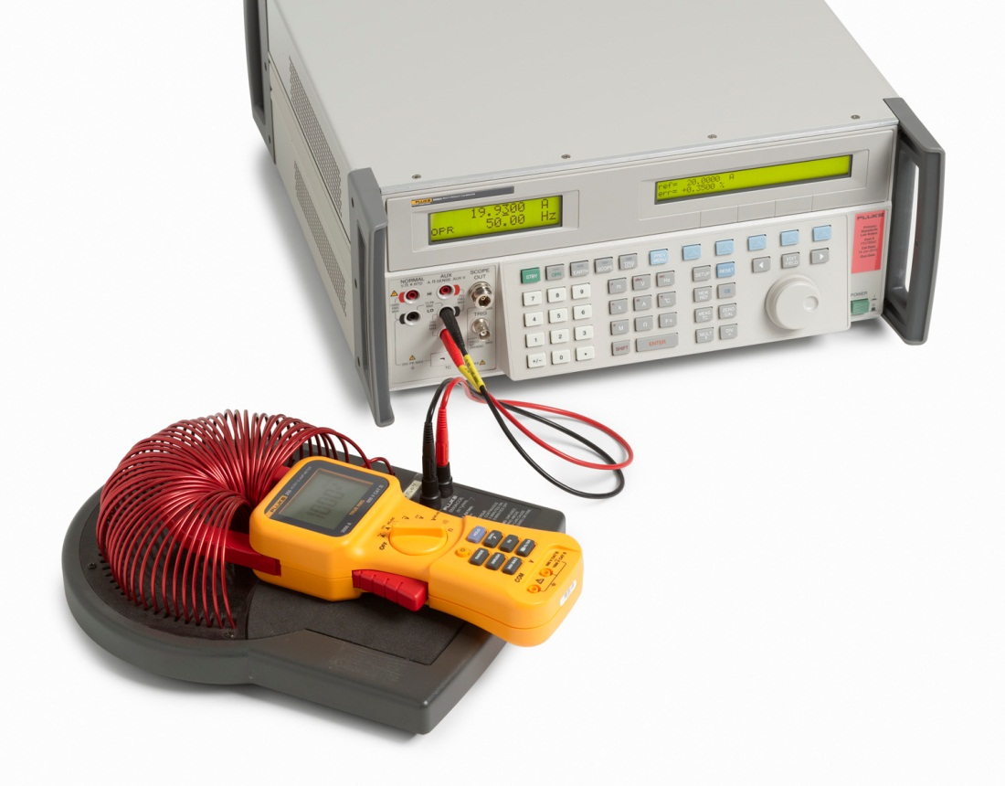
Frequently Asked Questions

Slide 8
Frequently asked questions -
What comes standard with the 5502A? The 5502A calibrator comes standard with all its various electrical functions. Scope calibration capability is optional. Included is a full report of calibration with data. An accredited report of calibration is optional.
What options can be installed in the 5502A? The two scope calibration options (300 MHz and 600 MHz) are the only options for this calibrator. These are available at time or purchase or installed by a service center at a future date as an upgrade.
Is MET/CAL compatible with the 5502A? Yes MET/CAL Release Version 8.1 is able to fully control the 5502A (Due out in Q3 2012).
How will existing MET/CAL users get this version of MET/CAL? Upgrades are available through the Gold support program, or as a purchased upgrade.

Slide 9
Frequently asked questions -
Will existing MET/CAL 5500 or 9100 procedures work with the 5502A? No, because the calibrator’s output terminal configuration is different – and the resulting operator safety issues – a different FSC must be used to operate the 5502A with MET/CAL (rather than use the existing 5500A or 9100 FSCs).
Will the 5502A FSC use the old 5500A style syntax, or the newer 5522A style syntax? The 5502A will use the new Name Value Instrument syntax (NVI) – giving the user better flexibility in use, editing, and future calibrator upgrade compatibility. The 5500A used the old FSC syntax style MET/CAL implemented the 5502A with the new structure of FSC, similar to the 5522A FSC. As a result any 5500A procedures will need to be converted to the new FSC syntax. This can be done by the MET/CAL user, or by a translator process. More information on the translation process will soon to be furnished by the MET/CAL team. Similarly any existing 9100 procedures will need to be translated to the new 5502A MET/CAL FSC syntax.

Slide 10
Frequently asked questions -
Does the 5502A use same the commands of other Fluke 55XX calibrators? Yes the 5502A uses the same remote control commands as the earlier 5500A, 5520A and 5522A series calibrators. The only difference is that it answers the remote ID command with a response - that of being a 5502A.
Does the 5502A emulate the commands of Fluke/Wavetek 9100 calibrators? No the 5502A does not emulate the Fluke/Wavetek 9100 calibrator remote control commands.
Is 5500A upgradable to 5502A? No a 5500A is not upgradeable to a 5502A.

Slide 11
Frequently asked questions -
Is 5502A upgradable to 5522A? No a 5502A is not upgradeable to a 5522A.
Will the user/operator manual be available together with 5502A at the same time? Yes, a full user’s manual will be available with the 5502A, in English language, supplied on a CD/DVD with the instrument. The getting started manual will translated in several languages, printed and supplied with the instrument.
Is the calibration procedure to calibrate the 5502A will be the same as 5500A? The performance verification procedure for the 5502A is similar, but not identical to the 5500A procedure. There are some range and specification differences between the two instruments.
Is a service manual available for the 5502A? A detailed service manual will be available at approximately one year after introduction.

